Slide 1

Restaurant Management System
Final Evaluation
Presenter
Snowber Hamid(2020A1R065)
CSE -5th semester
DEPARTMENT OF COMPUTER SCIENCE AND ENGINEERING
MIET(Autonomous),JAMMU

Slide 2
Contents
Problem Statement
Solution
Teck Stack and Modules
Tkinter overview
Time module overview
Random module overview
Features
Diagrammatic Representation
Demonstration
References
11/04/2022
Restaurant Management System

Slide 3
Problem Statement
Many hotels manage their workflow by paper work and manually
which take time.
The traditional method of ordering food and bill making in a
restaurant is very time consuming.
It leads to wastage of paper as well as time
11/04/2022
Restaurant Management System

Slide 4
Solution
Restaurant Management System is a system that helps the restaurant manager to manage the restaurant more effectively and efficiently by computerizing the billing and takes care of the tax etc.
11/04/2022
Restaurant Management System

Slide 5
Tech Stack and Modules
Tkinter
Python
Time Module
Random Module
11/04/2022
Restaurant Management System

Slide 6

Tkinter
Tkinter is a standard GUI library in python.When we use python and Tkinter together they provide a fast and easy way to create gui applications. Out of all GUI methods, Tkinter is most commonly used method.
Fig;(a)
Reference: shorturl.at/myMVX
11/04/2022
Restaurant Management System

Slide 7
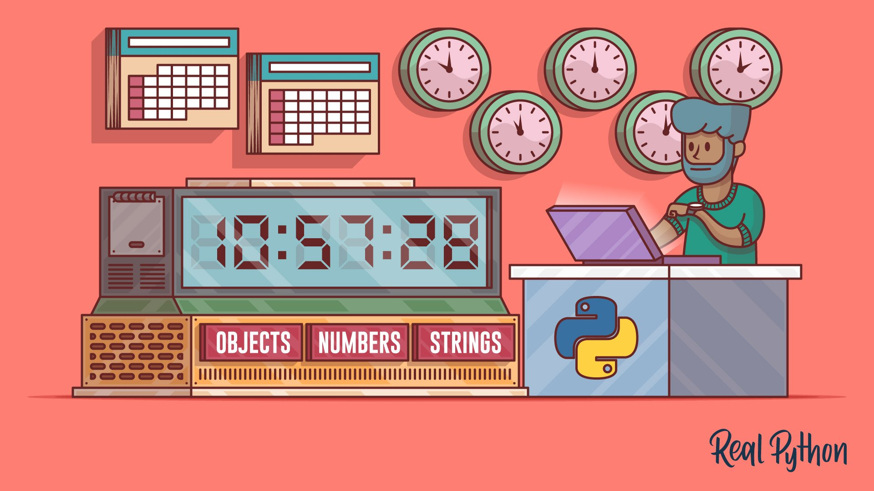
Time module
Python Time module provides various methods of representing time in the code, such as objects, strings, numbers.
Fig;(b)
Reference: shorturl.at/foz01
11/04/2022
Restaurant Management System

Slide 8

Random Module
Python random module is an in-built module in python which is used to generate numbers in python. These are the pseudo-random numbers means they are not truly random.
Fig;(c)
Reference: shorturl.at/IOPWZ
11/04/2022
Restaurant Management System

Slide 9
Features
Build a feature rich in automatic billing
Easy menu setup
User friendly system
Tracking sales
Speedy
11/04/2022
Restaurant Management System

Slide 10
DIAGRAMMATIC REPRESENTATION
11/04/2022
Restaurant Management System

Slide 11
Dashboard
Select item
Cost
Payment
ADMIN
USER
11/04/2022
Restaurant Management System

Slide 12
DEMONSTRATION
11/04/2022
Restaurant Management System

Slide 13
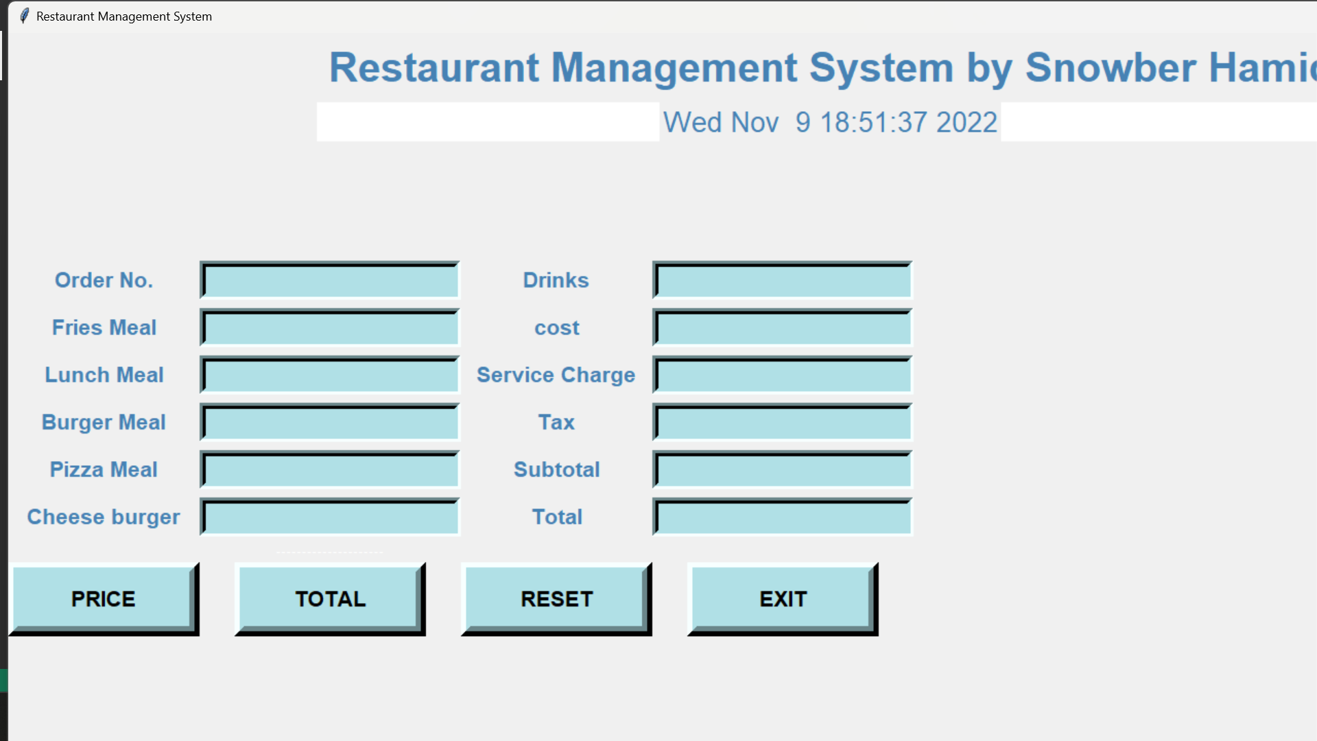
11/04/2022
Restaurant Management System

Slide 14
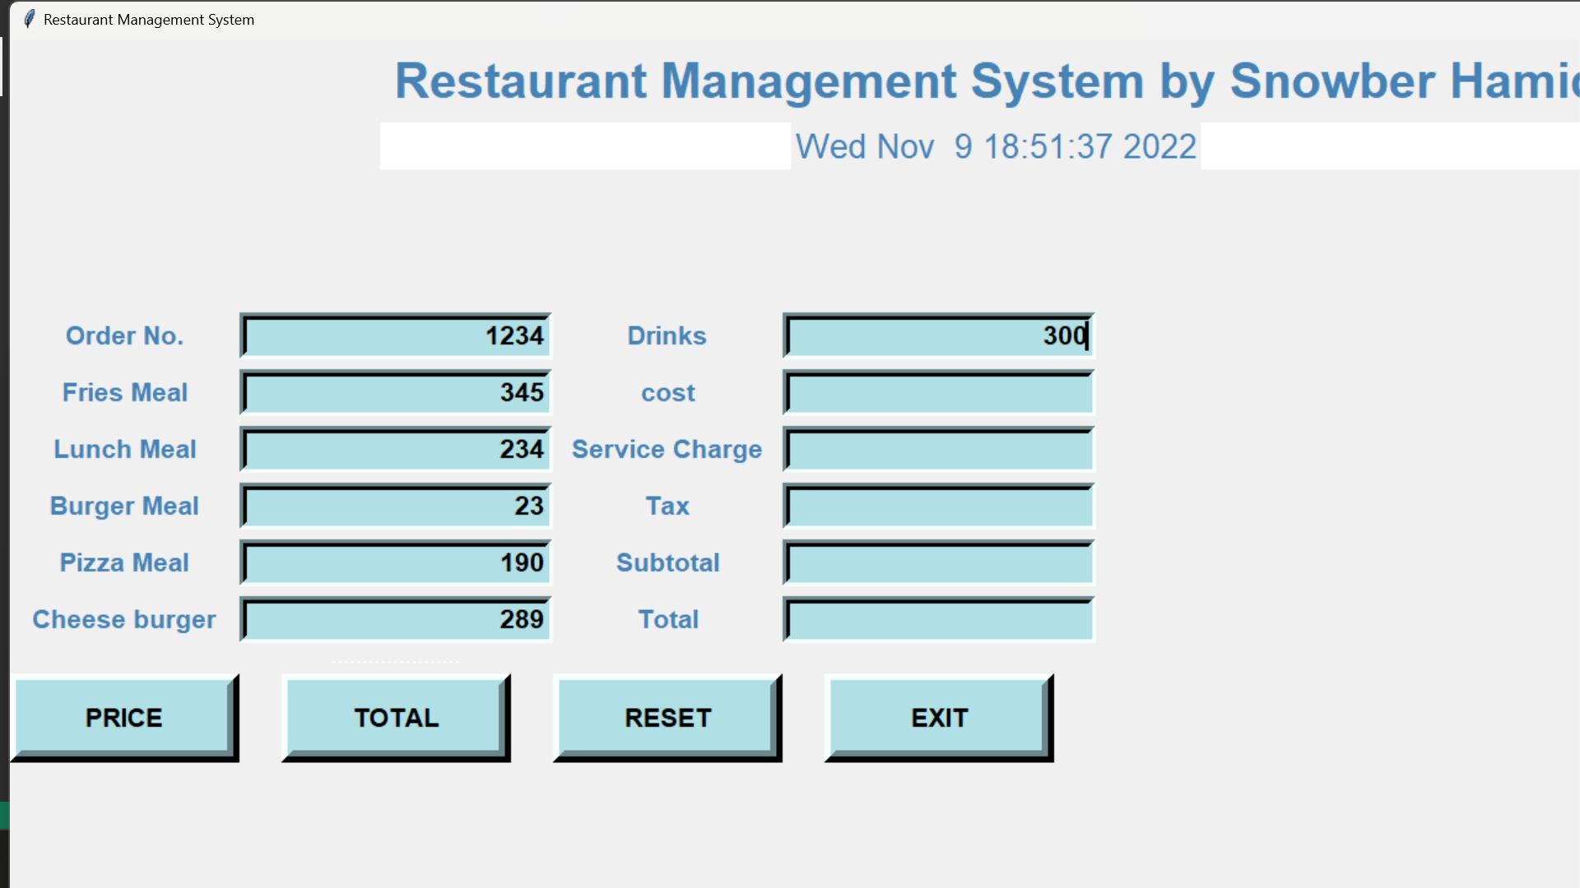
11/04/2022
Restaurant Management System

Slide 15
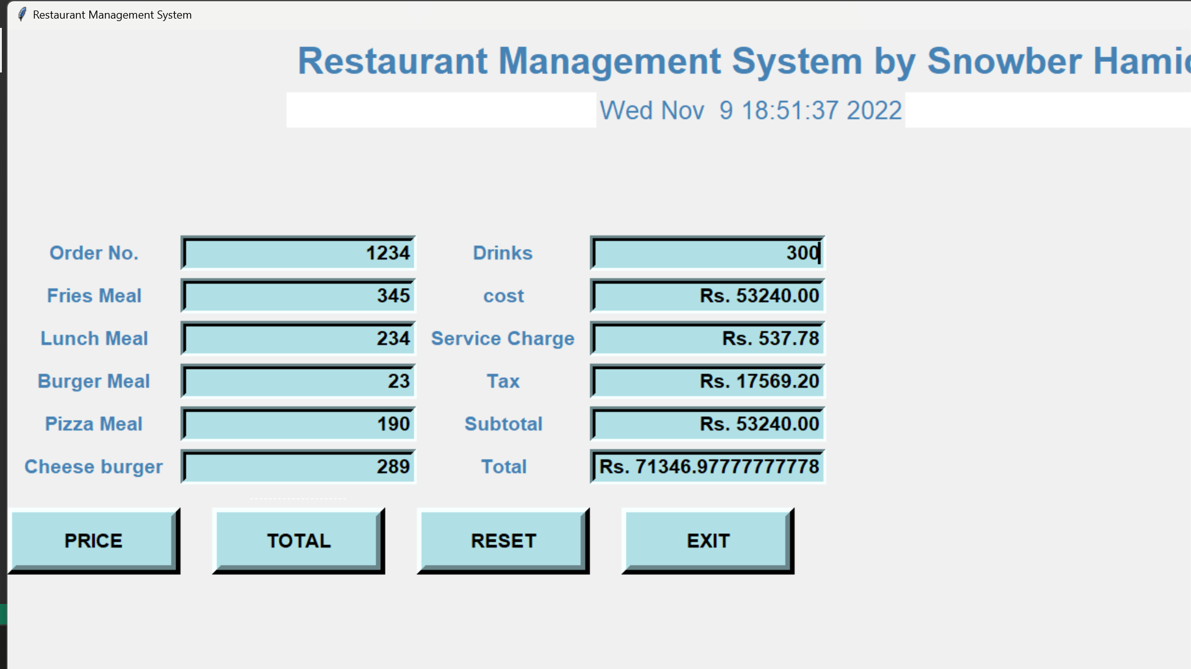
11/04/2022
Restaurant Management System

Slide 16
References
Reference 1:
https://github.com/amark23/Restaurant-Management-System-Python-/blob/master/restaurant.py
https://www.grin.com/document/384237#:~:text=1.2.-,PROBLEM%20STATEMENT,was%20a%20time%2Dconsuming%20process.
Reference 2:
11/04/2022
Restaurant Management System

Slide 17
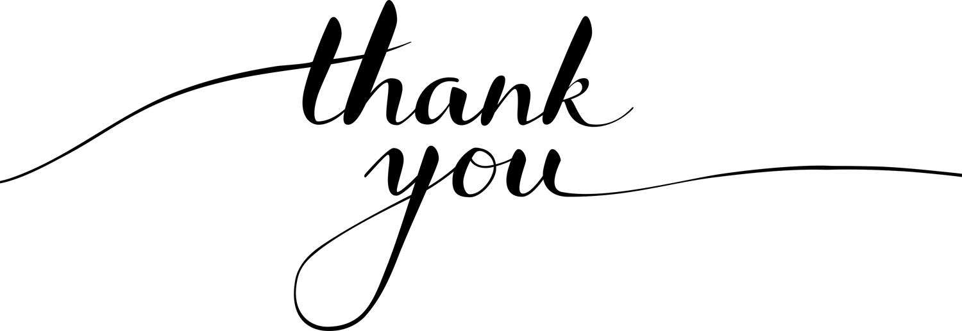
11/04/2022
Restaurant Management System

